Slide 1

RATIO ANALYSIS
Financial Management(HS4L003)
Dr. Naresh Chandra Sahu
Associate Professor (Economics)
School of Humanities, Social Sciences & Management
Indian Institute of Technology, Bhubaneswar

Slide 2

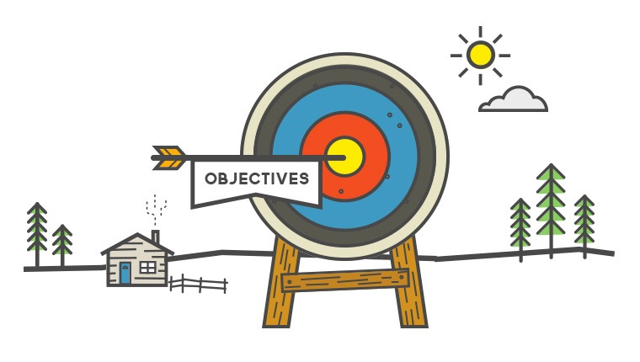
Learning Outcomes
Meaning, objectives, and limitations of accounting ratios
Identify the various types of ratios commonly used
Calculate various ratios to assess the solvency, liquidity, efficiency, and profitability of the firm
Interpret the various ratios calculated for intra-firm and inter-firm comparisons.

Slide 3
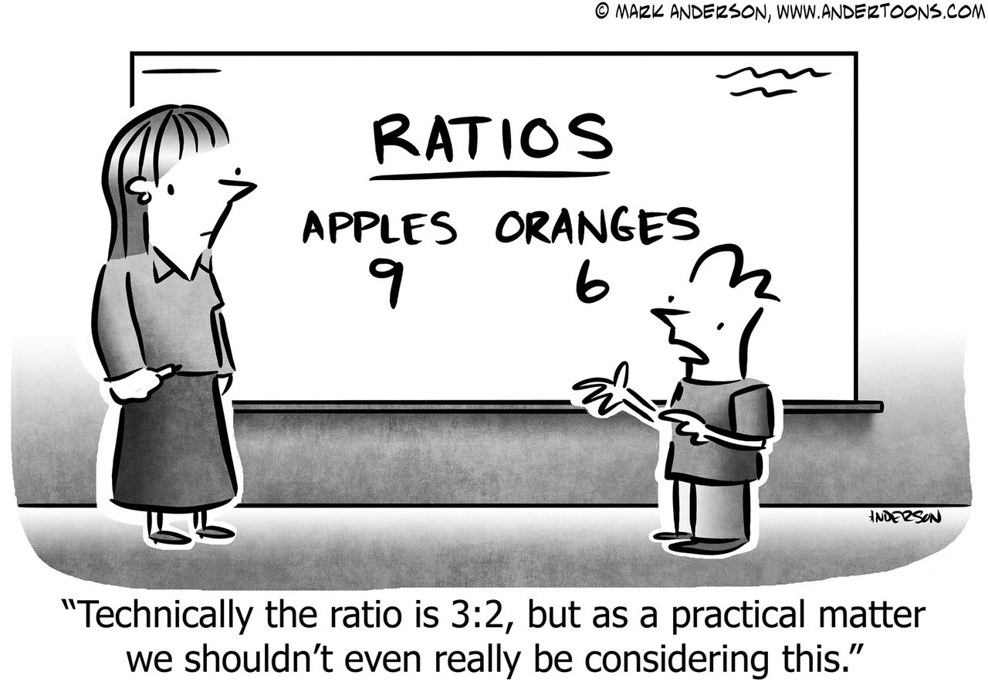
What is Ratio?
Ratio is a relationship between two or more items.
It is:-
1. Mathematical relationship between two items
2. Expressed in quantitative form
Defined as:
“relationships expressed in quantitative terms, between figures which have cause and effect relationships or which are connected in some manner or other.”

Slide 4
Objectives of Ratio Analysis
Measure profitability (Is the company earning enough profit?)
Check liquidity (Can it pay short-term obligations?)
Assess solvency (Is it safe for long-term creditors?)
Understand operational efficiency (How well assets are used?)
Compare the performance with past years, competitors, and industry standards
Aid in decision-making for investors, creditors, and management

Slide 5
How a Ratio is expressed?
As a Percentage, such as 25% or 50%. For example, if net profit is Rs. 25,000/- and the sales are Rs. 1,00,000/-, then the net profit can be said to be 25% of the sales.
As Proportion - The above figures may be expressed in terms of the relationship between net profit to sales as 1 : 4.
As Pure Number /Times me can also be expressed in an alternative way, such as the sale is 4 times the net profit or profit is 1/4th of the sales.

Slide 6
Steps in Ratio Analysis
Step 1
Selection of relevant information
Step 2
Calculation of appropriate ratios from the data
Step 3
Comparison of calculated ratio
Step 4
Analysis and interpretation of the ratios

Slide 7
Traditional Classification of Ratios
Balance Sheet Ratio | P&L Ratio or Income/Revenue Statement Ratio | Composite Ratio (Balance Sheet and Profit & Loss Ratio)
Financial Ratio | Operating Ratio | Composite Ratio
Current Ratio Quick Asset Ratio Proprietary Ratio Debt Equity Ratio | Gross Profit Ratio Operating Ratio Expense Ratio Net Profit Ratio Stock Turnover Ratio | Fixed Asset Turnover Ratio Return on Total Resources Ratio Return on Own Funds Ratio Earning per Share Ratio, Debtors’ Turnover Ratio,

Slide 8

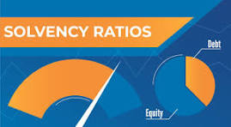

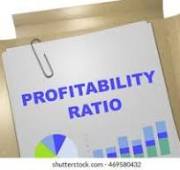
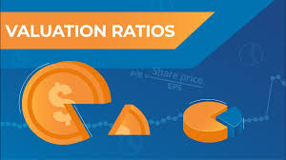
Functional Classification of Ratios

Slide 9

Liquidity Ratios
Liquidity is the ease with which assets may be converted into cash without loss in value of assets.
"Liquidity" refers to the ability of the firm to meet its current liabilities. The liquidity ratios, therefore, are also called 'Short-term Solvency Ratios.
These ratios are used to assess the short-term financial position of the concern. They indicate the firm's ability to meet its current obligations out of current resources.
Liquidity ratios include two ratios: -
Current Ratio
Quick Ratio

Slide 10

Liquidity Ratios
Current Ratio
The main question this ratio addresses is: Does the business have enough current assets to meet its current debts?
A generally acceptable current ratio is 2:1.
The ideal Current Ratio preferred by Banks is 1.33: 1
But whether or not a specific ratio is satisfactory depends on the nature of the business and the characteristics of its CA and CL.

Slide 11
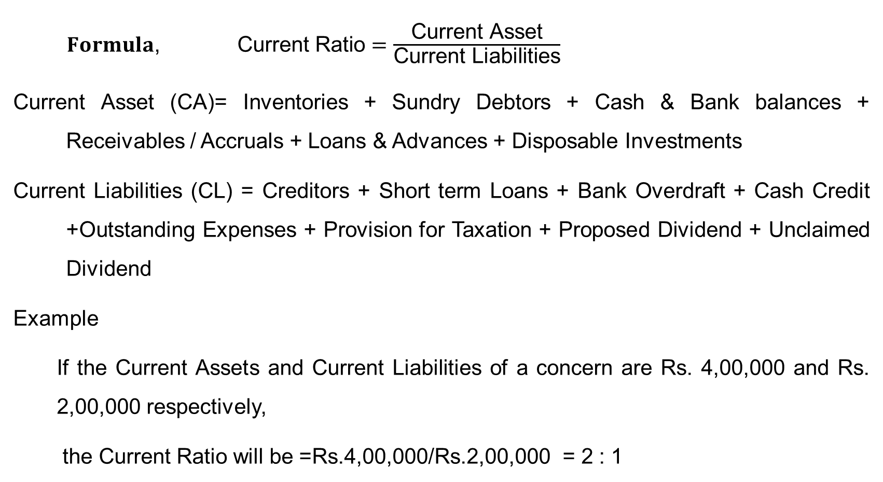
Liquidity Ratios
$Formula\text{, } \text{Current} \text{Ratio}=\frac{\text{Cu}\text{rrent} \text{Asset}}{\text{Curren}\text{t} \text{L}\text{iabilities}}$
Current Asset (CA)= Inventories + Sundry Debtors + Cash & Bank balances + Receivables / Accruals + Loans & Advances + Disposable Investments
Current Liabilities (CL) = Creditors + Short term Loans + Bank Overdraft + Cash Credit +Outstanding Expenses + Provision for Taxation + Proposed Dividend + Unclaimed Dividend
Example
If the Current Assets and Current Liabilities of a concern are Rs. 4,00,000 and Rs. 2,00,000 respectively,
the Current Ratio will be =Rs.4,00,000/Rs.2,00,000 = 2 : 1

Slide 12
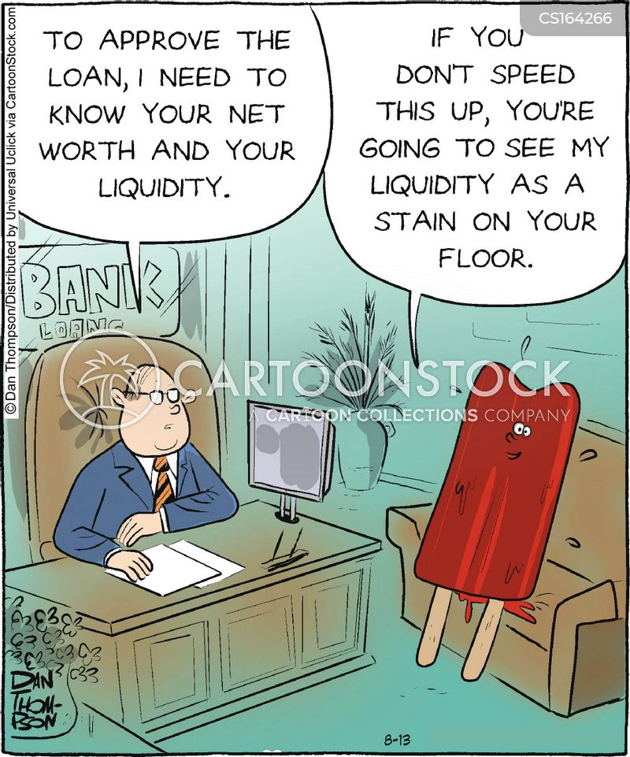
Liquidity Ratios
Quick Ratio
The quick ratio is a much more conservative measure than the current ratio.
This ratio measures the immediate solvency of the company.
The ideal liquid ratio is 1:1. This is irrespective of the nature of the business.

Slide 13

Liquidity Ratios
ACID TEST or QUICK RATIO : It is the ratio between Quick Current Assets and Current Liabilities. The should be at least equal to 1.
Quick Current Assets : Cash/Bank Balances + Receivables up to 6 months + Quickly realizable securities such as Govt. Securities or quickly marketable/quoted shares and Bank Fixed Deposits
Acid Test or Quick Ratio = Quick Current Assets/Current Liabilities
Example :
Cash 50,000
Debtors 1,00,000
Inventories 1,50,000 Current Liabilities 1,00,000
Total Current Assets 3,00,000
Current Ratio = > 3,00,000/1,00,000 = 3 : 1
Quick Ratio = > 1,50,000/1,00,000 = 1.5 : 1

Slide 14

Liquidity Ratios
$$\text{C}\text{ash} \text{Ratio}=\frac{\text{Cash} \text{and} \text{Cash} \text{equivalents}}{\text{Current} \text{Liabilities}}$$
The cash ratio measures a company’s ability to pay off short-term liabilities with cash and cash equivalents

Slide 15


Slide 16
Answer:
Liquidity ratios measure a company’s ability to meet its short-term obligations using its current assets (like cash, receivables, and inventory).
Inventory is not as liquid as cash, because you can’t instantly use it to pay bills—it needs to be sold first
While inventory is counted as a current asset in the current ratio, it doesn’t immediately give cash like the quick ratio or cash ratio.

Slide 17
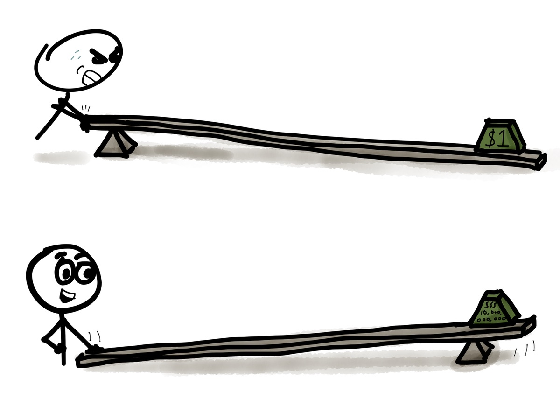
Solvency Ratios
These ratios are calculated to assess the ability of the firms to meet its long-term liabilities as and when they become due.
Long term creditors including debenture holders are primarily interested to know whether the company has ability to pay regularly interest due to them and to repay the principal amount when it becomes due.
Solvency ratios disclose the firm’s ability to meet the interest costs regularly and long-term indebtedness at maturity.

Slide 18

Solvency Ratios
Solvency ratios include the following ratios:-
Debt-Equity Ratio
Capital Gearing Ratio
Proprietary Ratio
Interest Coverage Ratio
Debt Service Coverage Ratio

Slide 19
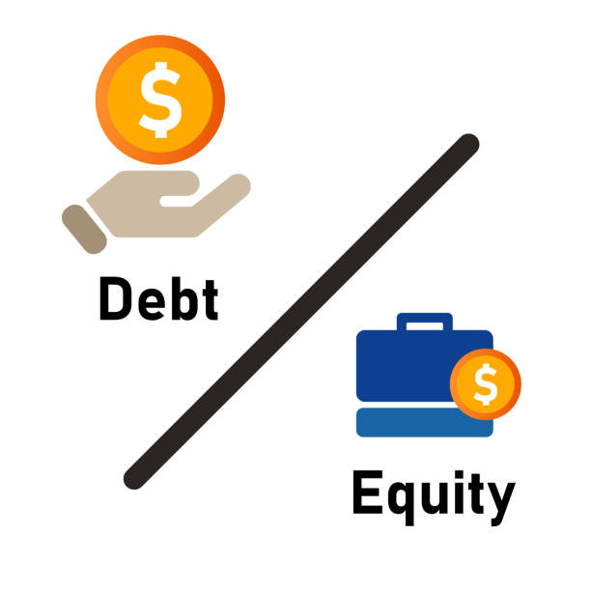
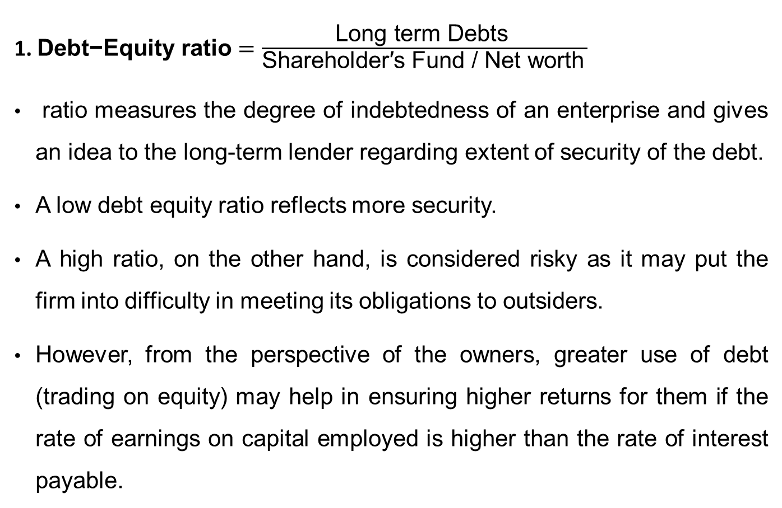
Solvency Ratios
1.$\text{Debt}\text{−}\text{Equity} \text{ratio}=\frac{\text{Long} \text{term} \text{Debts} }{{\text{Shareholder}\text{′}\text{s} \text{Fund}\text{ / }\text{Net} \text{worth}}^{ }}$
ratio measures the degree of indebtedness of an enterprise and gives an idea to the long-term lender regarding extent of security of the debt.
A low debt equity ratio reflects more security.
A high ratio, on the other hand, is considered risky as it may put the firm into difficulty in meeting its obligations to outsiders.
However, from the perspective of the owners, greater use of debt (trading on equity) may help in ensuring higher returns for them if the rate of earnings on capital employed is higher than the rate of interest payable.

Slide 20
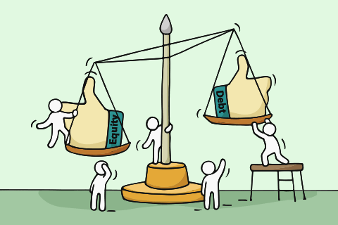
Solvency Ratios
Long Term Outside Liabilities / Net Worth
Liabilities of Long-Term Nature
Total of Capital and Reserves & Surplus Less Intangible Assets
For instance, if the Firm is having the following :
Capital = Rs. 200 Lacs
Free Reserves & Surplus = Rs. 300 Lacs
Long Term Loans/Liabilities = Rs. 800 Lacs
Debt Equity Ratio will be => 800/500 i.e. 1.6 : 1

Slide 21

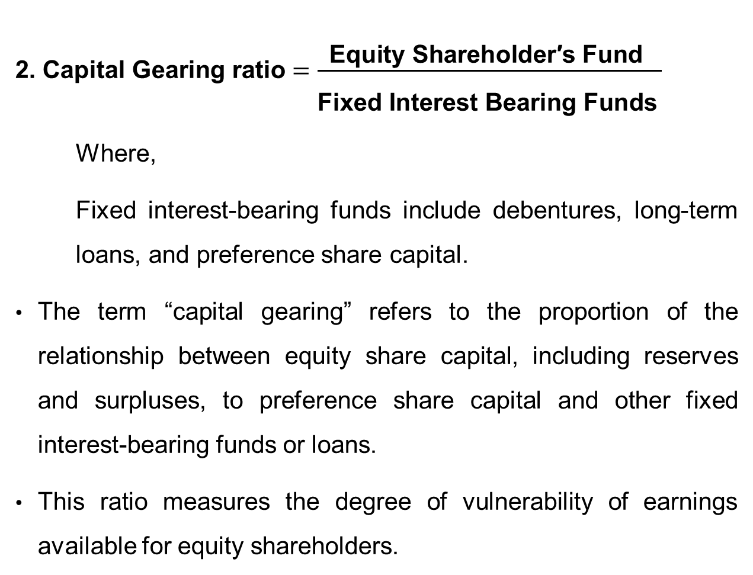
Solvency Ratios
2. $\text{Capital} \text{Gearing} \text{ratio}=\frac{\text{Equity} \text{Shareholder}\text{′}\text{s} \text{Fund} }{{\begin{aligned} \\ \text{Fixe}\text{d} \text{Interest} \text{Bearing} \text{F}\text{unds}\end{aligned}}^{ }}$
Where,
Fixed interest-bearing funds include debentures, long-term loans, and preference share capital.
The term “capital gearing” refers to the proportion of the relationship between equity share capital, including reserves and surpluses, to preference share capital and other fixed interest-bearing funds or loans.
This ratio measures the degree of vulnerability of earnings available for equity shareholders.

Slide 22
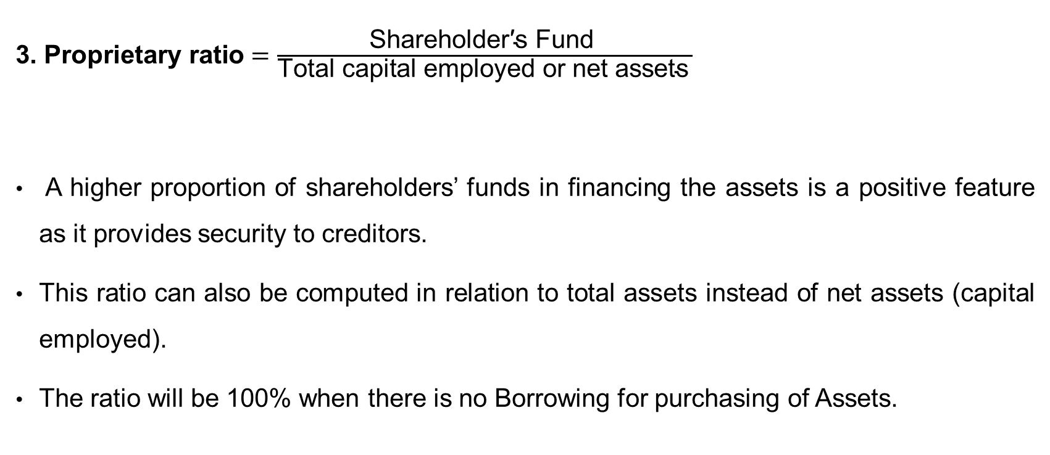
Solvency Ratios
3. $\text{Proprietary} \text{ratio}=\frac{\text{Shareholder}\text{′}\text{s} \text{Fund} }{{\text{Total} \text{capital} \text{employed} \text{or} \text{net} \text{assets}}^{ }}$
A higher proportion of shareholders’ funds in financing the assets is a positive feature as it provides security to creditors.
This ratio can also be computed in relation to total assets instead of net assets (capital employed).
The ratio will be 100% when there is no Borrowing for purchasing of Assets.

Slide 23
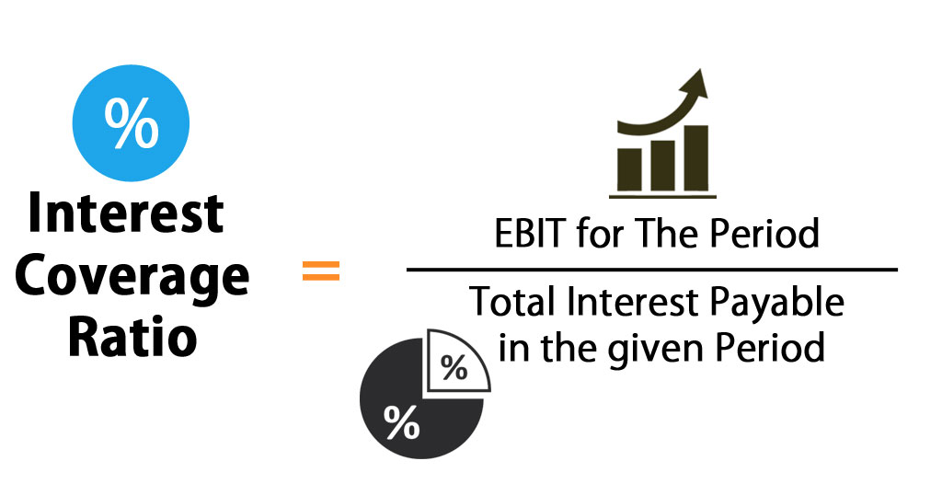
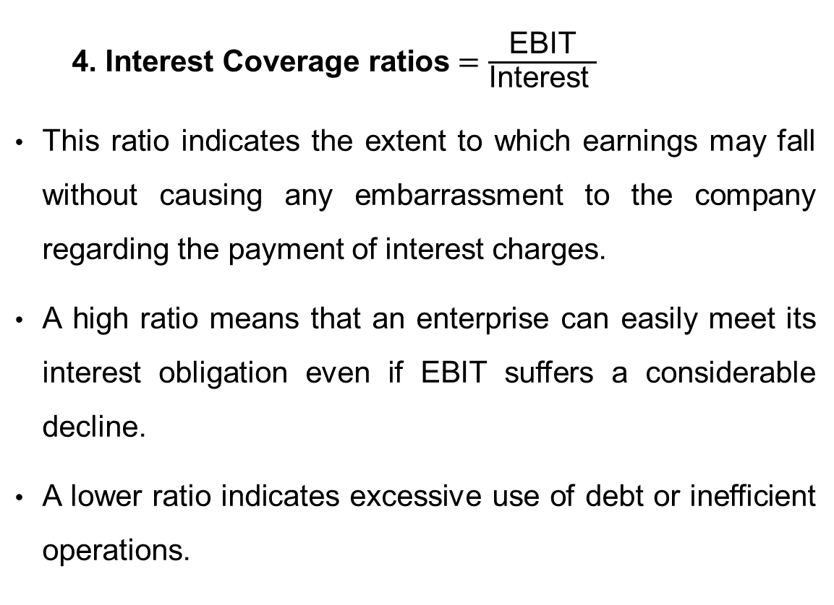
Solvency Ratios
$\text{ 4. }\text{Interest} \text{Covera}\text{ge} \text{ratios}=\frac{\text{EBIT}}{\text{Interest} }$
This ratio indicates the extent to which earnings may fall without causing any embarrassment to the company regarding the payment of interest charges.
A high ratio means that an enterprise can easily meet its interest obligation even if EBIT suffers a considerable decline.
A lower ratio indicates excessive use of debt or inefficient operations.

Slide 24

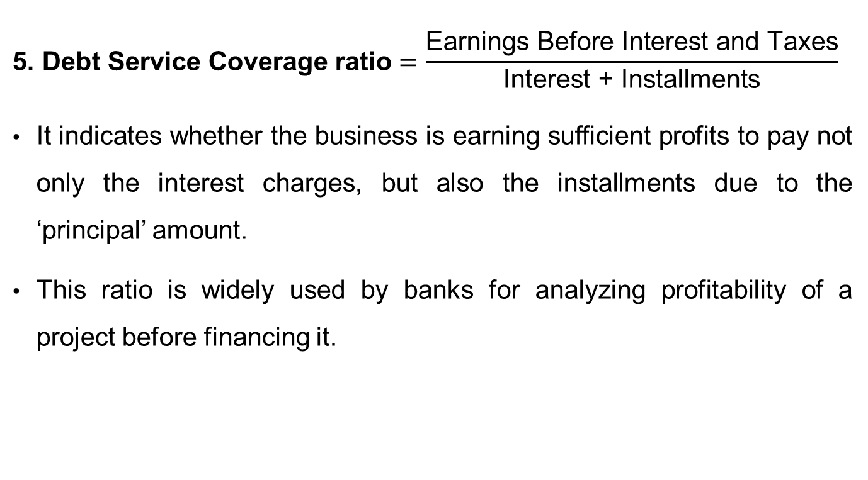
Solvency Ratios
$$\text{5. }\text{Debt} \text{Service} \text{Coverage} \text{ratio}=\frac{\text{Earnings} \text{Before} \text{Interest} \text{and} \text{Taxes}}{\text{Interest}\text{ + }\text{Installments}}$$
It indicates whether the business is earning sufficient profits to pay not only the interest charges, but also the installments due to the ‘principal’ amount.
This ratio is widely used by banks for analyzing profitability of a project before financing it.

Slide 25
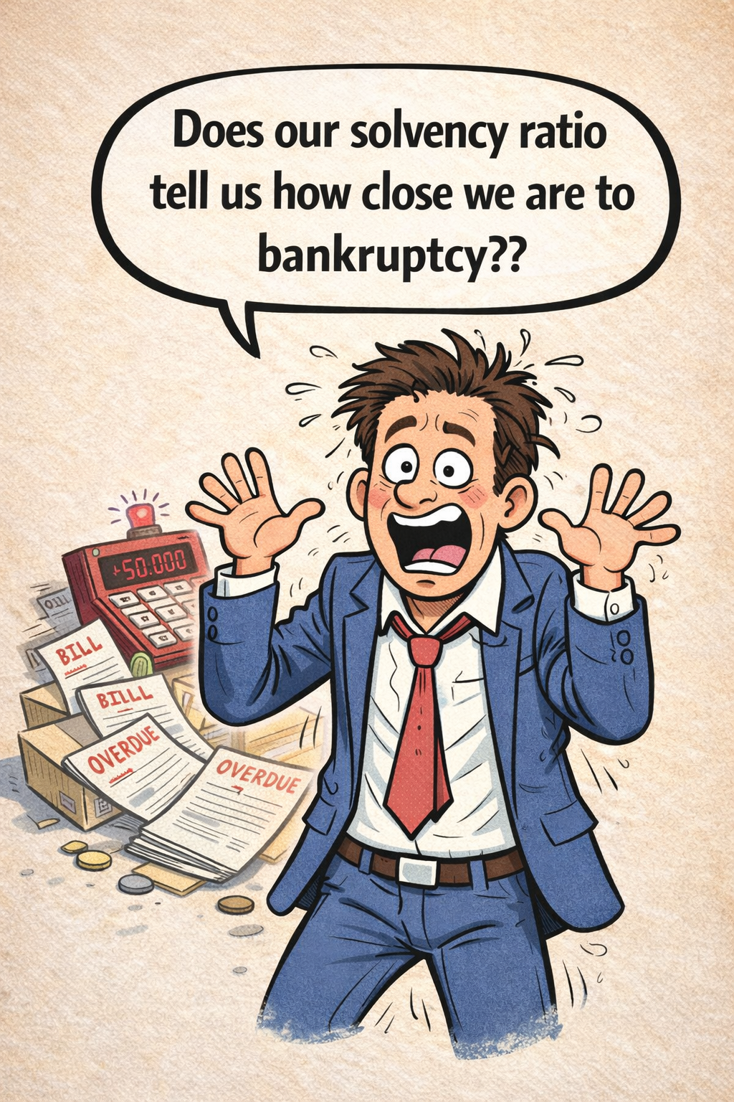

Slide 26

Activity Ratios
These ratios are calculated based on 'cost of sales' or ‘sales’; therefore, these ratios are also called 'Turnover Ratios’.
Turnover indicates the speed or number of times the capital employed has been rotated in the process of doing business.
In other words, these ratios indicate how efficiently the capital is being used to obtain sales; how efficiently the fixed assets are being used to obtain sales; and how efficiently the working capital and stock are being used to obtain sales.
Higher turnover ratios indicate the better use of capital or resources and, in turn, lead to higher profitability.

Slide 27
Answer:
Solvency ratios measure a company’s long-term ability to meet its debt obligations.
Common solvency ratios include:
Debt-to-Equity Ratio → How much debt the company has compared to its equity. Interest Coverage Ratio → How easily the company can pay interest on its debt.
A ratio usually means the company is financially stable and can pay its long-term debts.
A low solvency ratio or very high debt levels might indicate financial risk or potential trouble, but it does not automatically mean bankruptcy is imminent — it just signals caution.

Slide 28
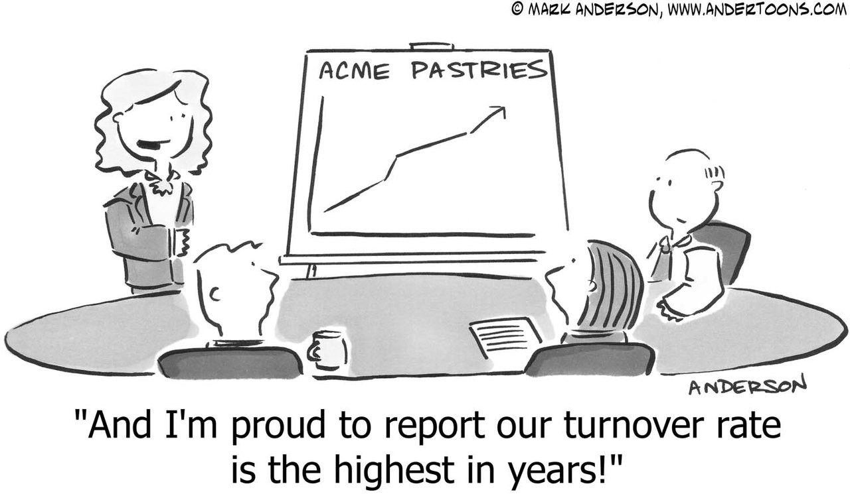
Activity Ratios
Activity ratios include the following:
Inventory Turnover Ratio
Accounts receivables Turnover Ratio
Accounts Payable Turnover Ratio
Average payment Period
Assets Turnover Ratio
Working capital Turnover Ratio
Investment Turnover Ratio

Slide 29
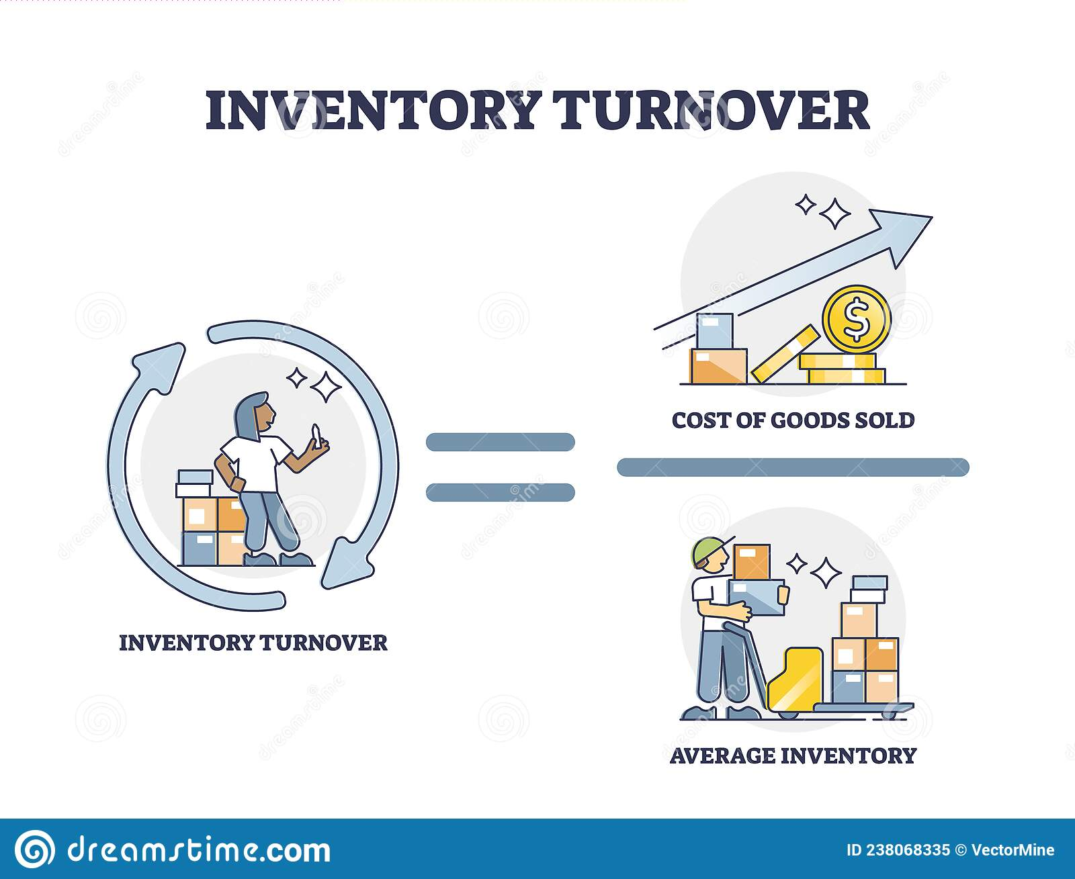
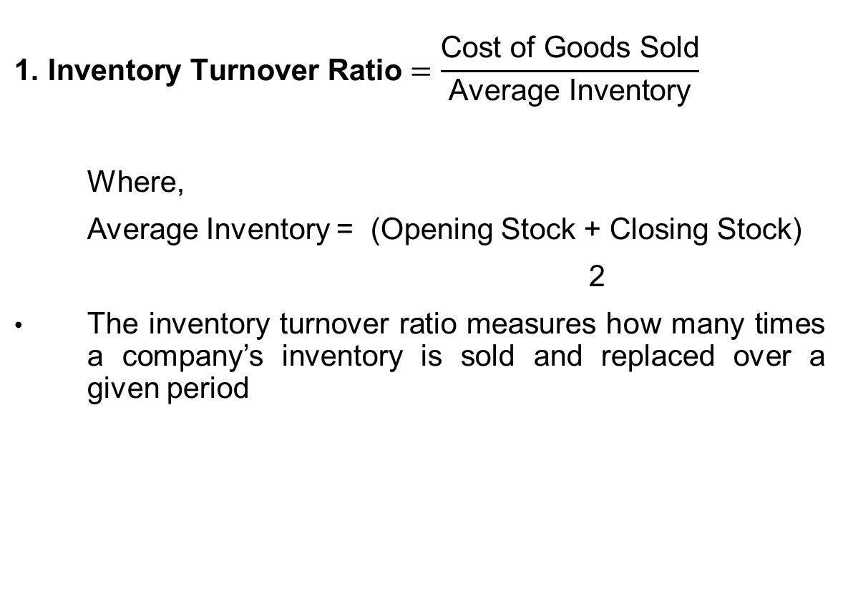
Activity Ratios
$$\text{1. }\text{Inventory} \text{Turnover} \text{Ratio}=\frac{\text{Cost} \text{of} \text{Goods} \text{Sold}}{\text{Average} \text{Inventory}}$$
Where,
Average Inventory = (Opening Stock + Closing Stock)
2
The inventory turnover ratio measures how many times a company’s inventory is sold and replaced over a given period

Slide 30
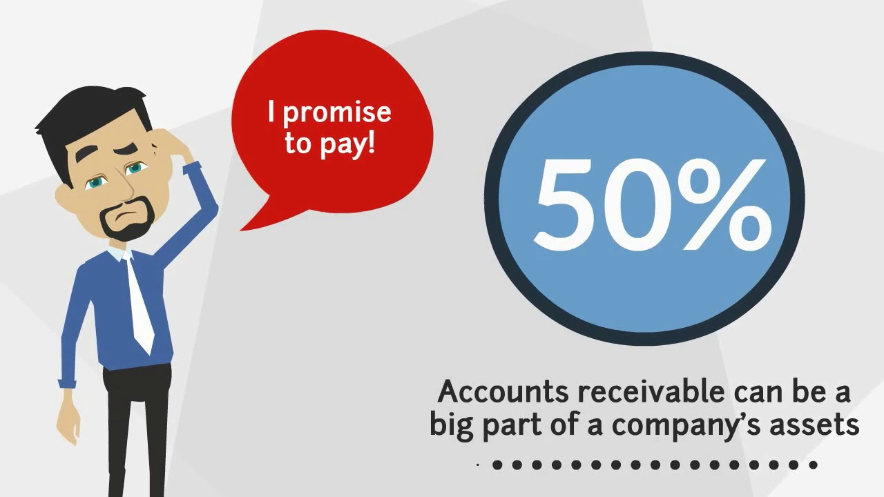
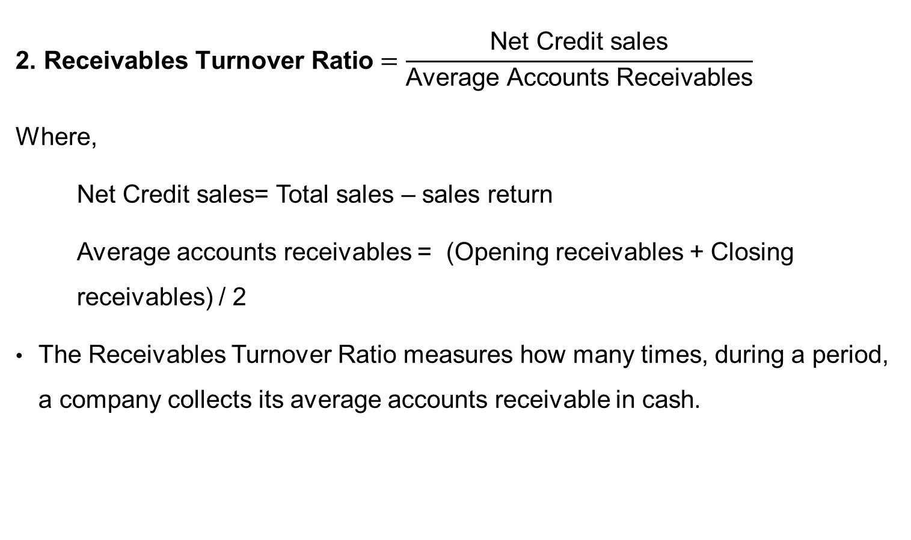
Activity Ratios
$$\text{2. }\text{R}\text{eceivables} \text{Turnover} \text{Ratio}=\frac{\text{Net} \text{Credit} \text{sales}}{\text{Avera}\text{ge} \text{Accounts} \text{Receivables}}$$
Where,
Net Credit sales= Total sales – sales return
Average accounts receivables = (Opening receivables + Closing receivables) / 2
The Receivables Turnover Ratio measures how many times, during a period, a company collects its average accounts receivable in cash.

Slide 31
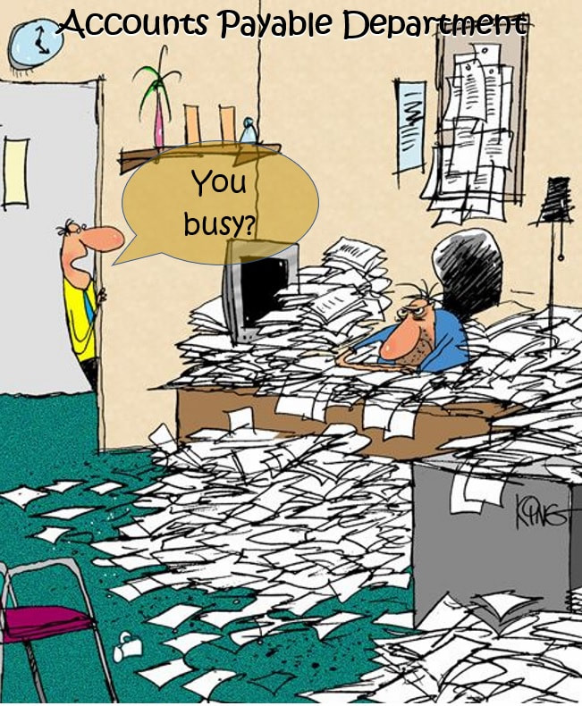
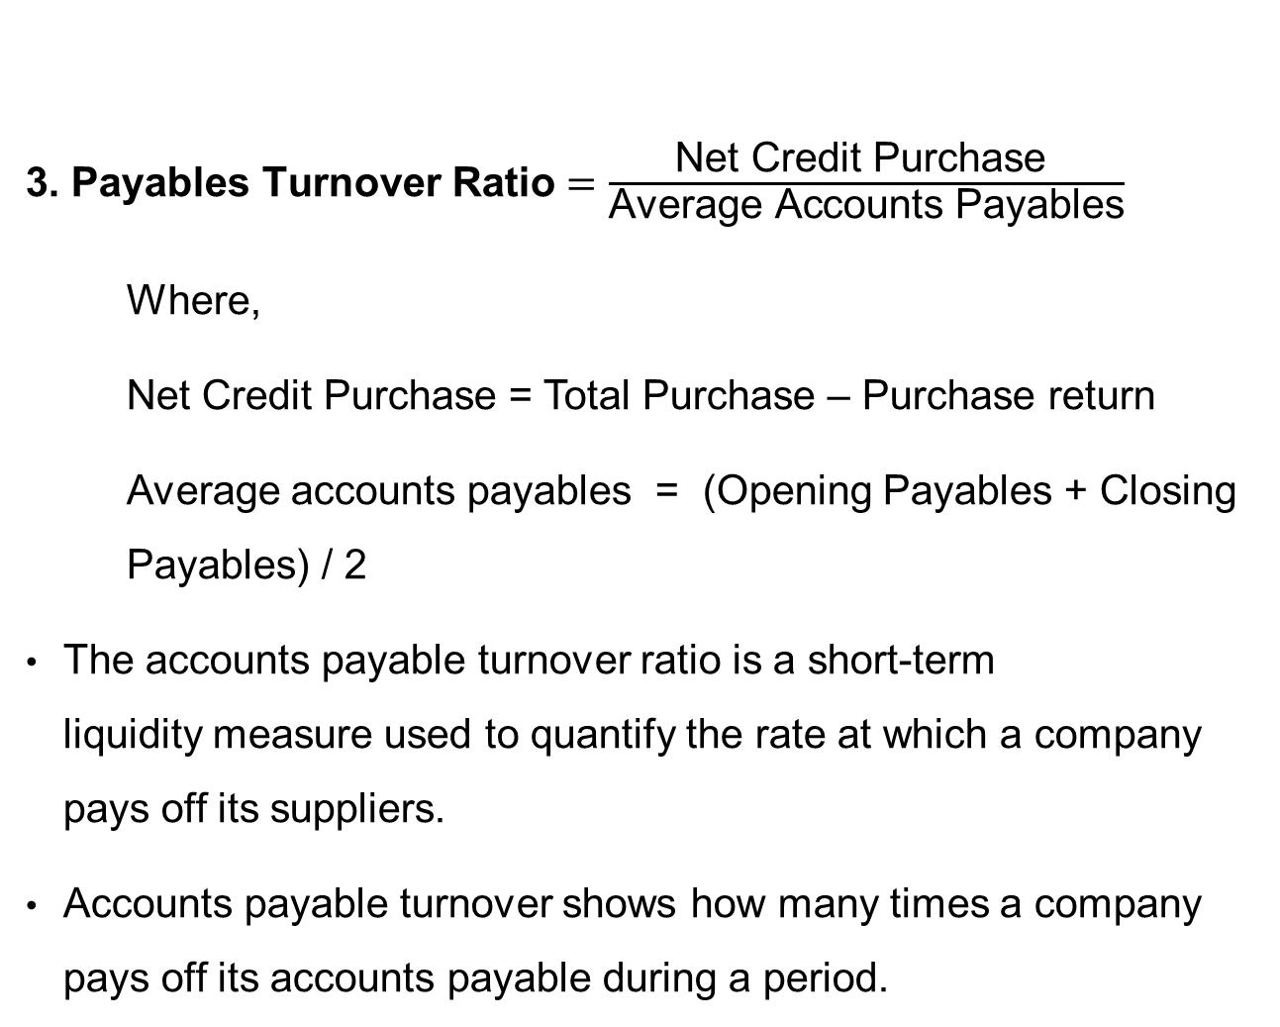
Activity Ratios
3. Pay$\text{ables} \text{Turnover} \text{Ratio}=\frac{\text{Net} \text{Credit} \text{Purchase} }{\text{Avera}\text{ge} \text{Accounts} \text{Payables}}$
Where,
Net Credit Purchase = Total Purchase – Purchase return
Average accounts payables = (Opening Payables + Closing Payables) / 2
The accounts payable turnover ratio is a short-term liquidity measure used to quantify the rate at which a company pays off its suppliers.
Accounts payable turnover shows how many times a company pays off its accounts payable during a period.

Slide 32
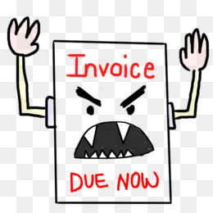
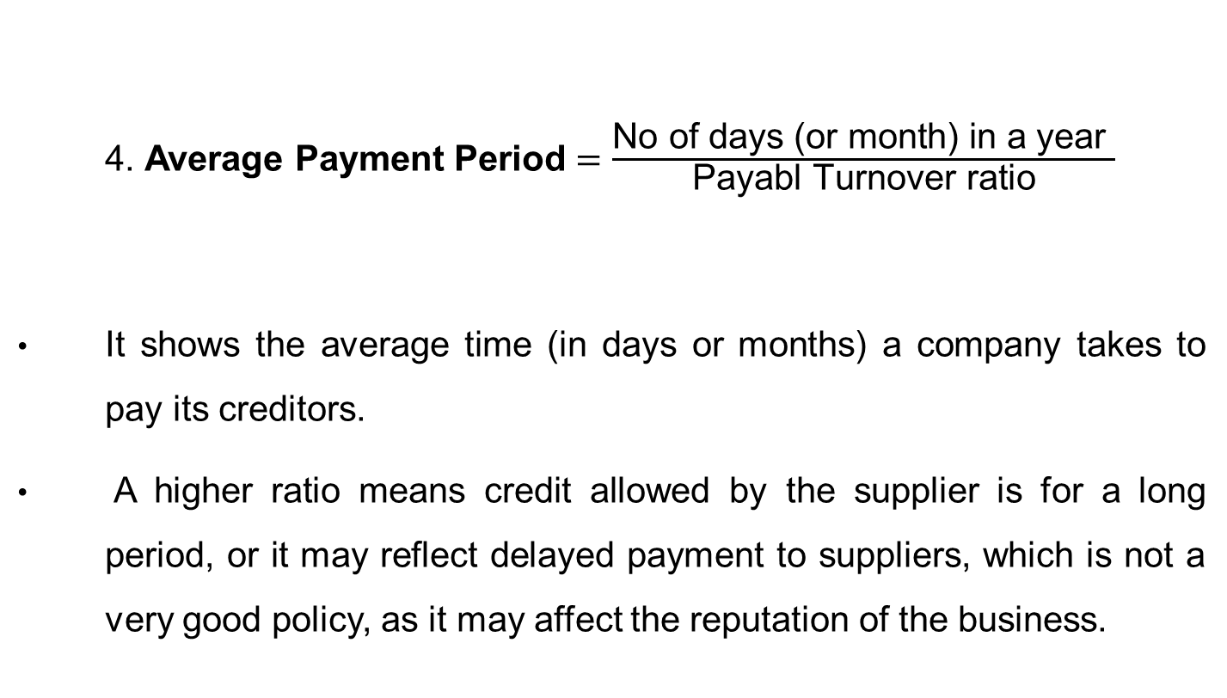
Activity Ratios
4. Average Payment Period $=\frac{\text{No} \text{of} \text{days}\text{ (}\text{or} \text{month}\text{)} \text{in} \text{a} \text{year} }{\text{Payabl} \text{Turnover} \text{ratio}}$
It shows the average time (in days or months) a company takes to pay its creditors.
A higher ratio means credit allowed by the supplier is for a long period, or it may reflect delayed payment to suppliers, which is not a very good policy, as it may affect the reputation of the business.

Slide 33
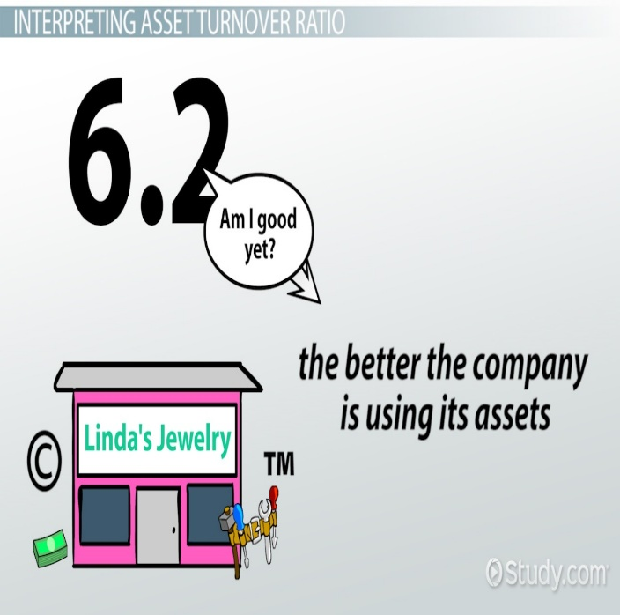
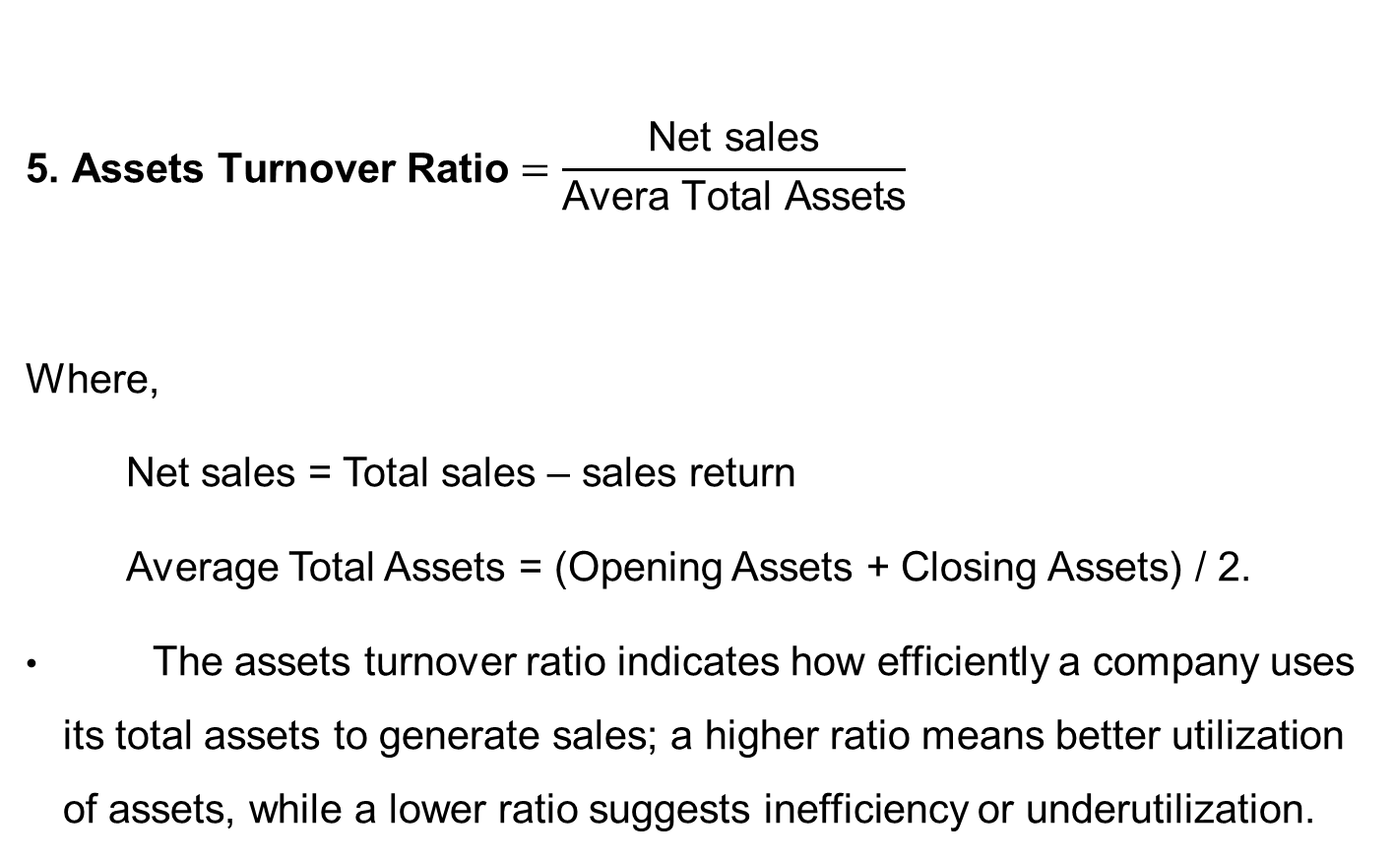
Activity Ratios
$$\text{5. }\text{A}\text{ssets} \text{Turnover} \text{Ratio}=\frac{\text{Net} \text{sales}}{\text{Avera} \text{Total} \text{Assets}}$$
Where,
Net sales = Total sales – sales return
Average Total Assets = (Opening Assets + Closing Assets) / 2.
The assets turnover ratio indicates how efficiently a company uses its total assets to generate sales; a higher ratio means better utilization of assets, while a lower ratio suggests inefficiency or underutilization.

Slide 34
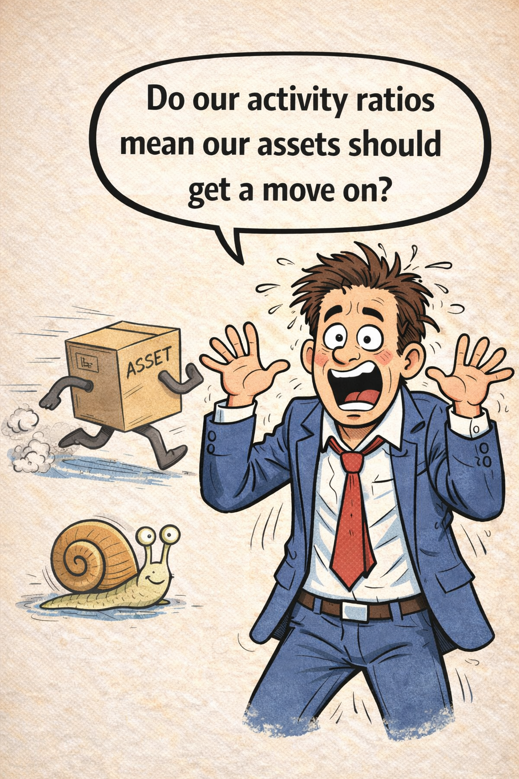

Slide 35
Profitability Ratios
Profitability Ratios measure the ability of a business to earn profits in relation to sales, assets, equity, or capital employed.
They indicate the overall efficiency of the business in generating earnings.
Higher profitability ratios show better financial health and effective utilization of resources.
Profitability ratios help in comparing performance over time or against industry standards.

Slide 36
Profitability Ratios
Profitability ratios include the following:
Gross Profit Ratio
Operating Ratio
Operating Profit Ratio
Net Profit Ratio
Return on Equity
Return on Assets
Return on Capital Employed

Slide 37
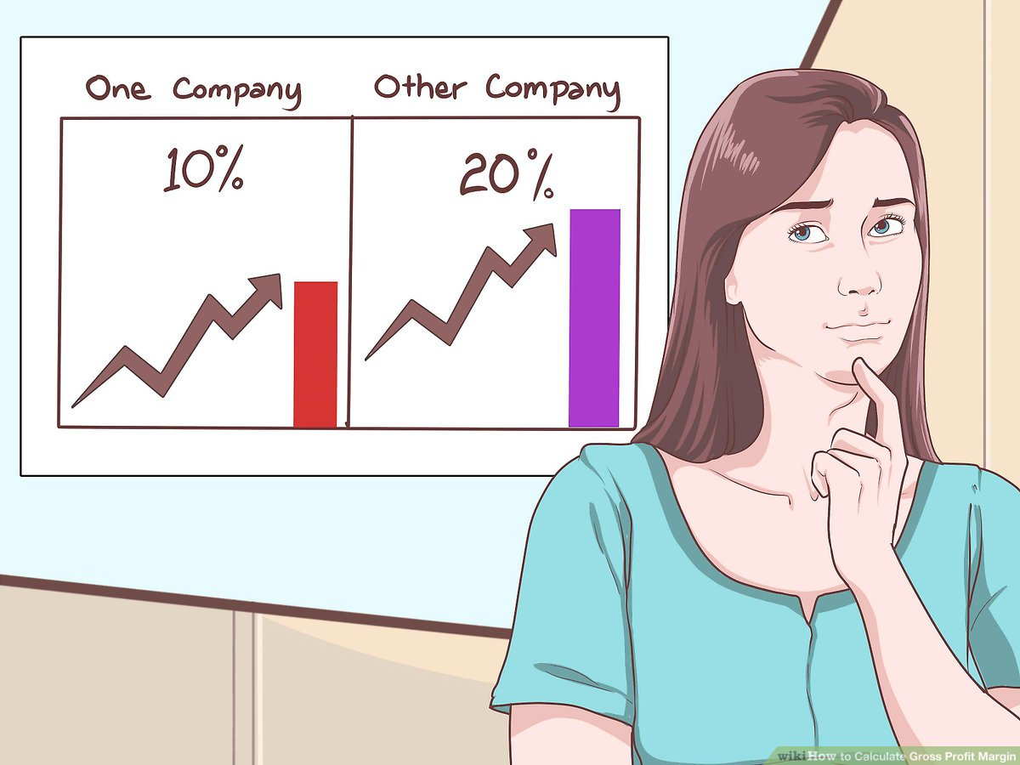
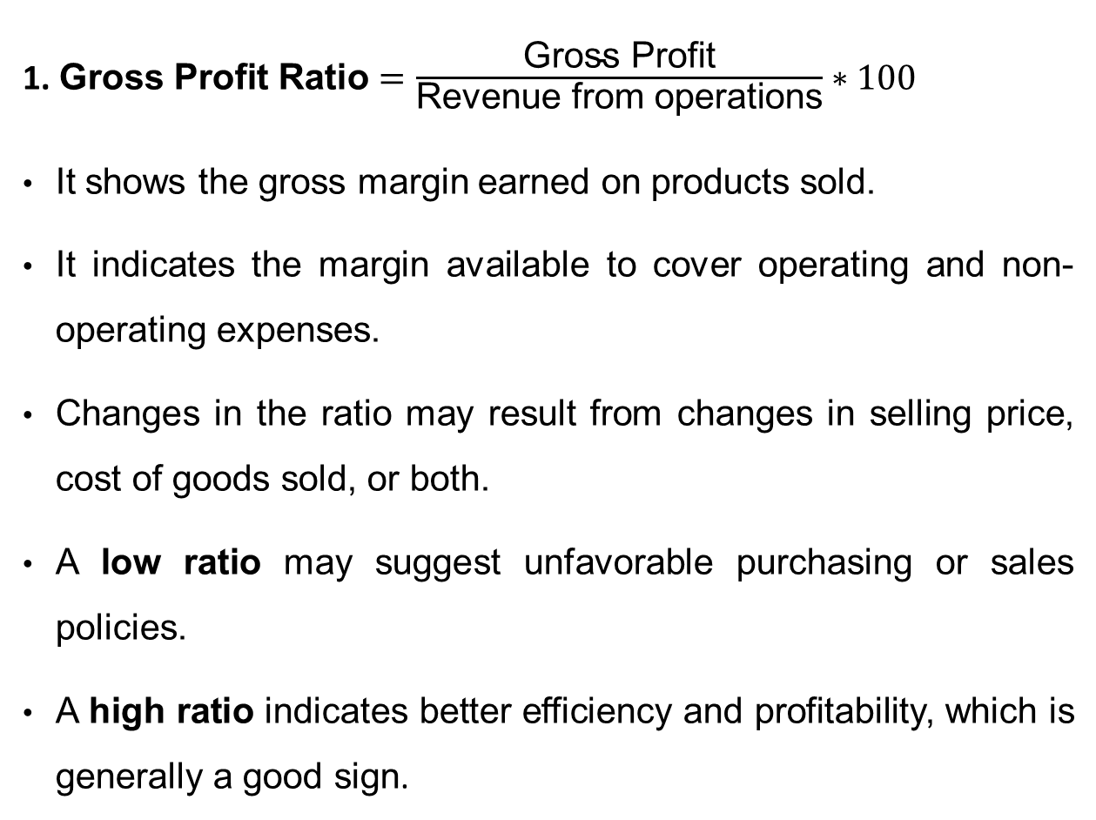
Profitability Ratios
1. $\text{G}\text{ross} \text{Profit} \text{Ratio}=\frac{\text{Gross} \text{Profit}}{\text{Revenue} \text{from} \text{operations}}∗100$
It shows the gross margin earned on products sold.
It indicates the margin available to cover operating and non-operating expenses.
Changes in the ratio may result from changes in selling price, cost of goods sold, or both.
A low ratio may suggest unfavorable purchasing or sales policies.
A high ratio indicates better efficiency and profitability, which is generally a good sign.

Slide 38

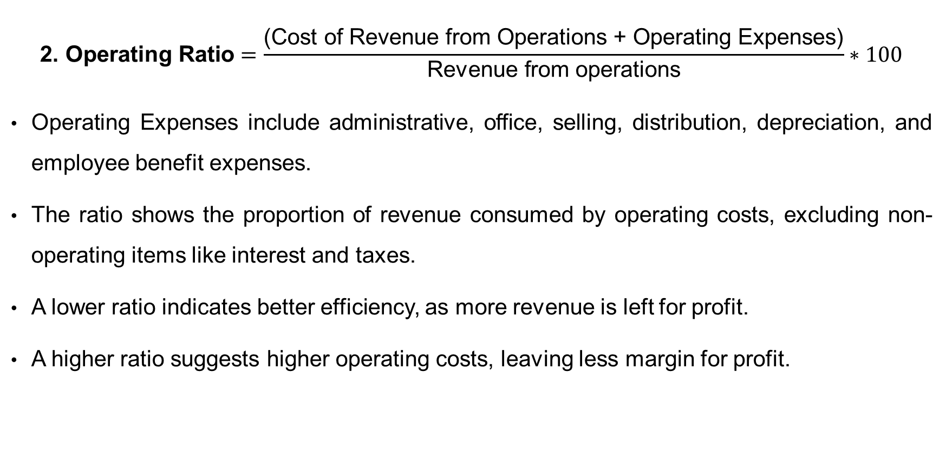
Profitability Ratios
$$\text{2. }\text{O}\text{perating} \text{Ratio}=\frac{\text{(}\text{Cost} \text{of} \text{Revenue} \text{from} \text{Operations}\text{ + }\text{Operating} \text{Expenses}\text{)}}{\text{Revenue} \text{from} \text{operations}}∗100$$
Operating Expenses include administrative, office, selling, distribution, depreciation, and employee benefit expenses.
The ratio shows the proportion of revenue consumed by operating costs, excluding non-operating items like interest and taxes.
A lower ratio indicates better efficiency, as more revenue is left for profit.
A higher ratio suggests higher operating costs, leaving less margin for profit.

Slide 39
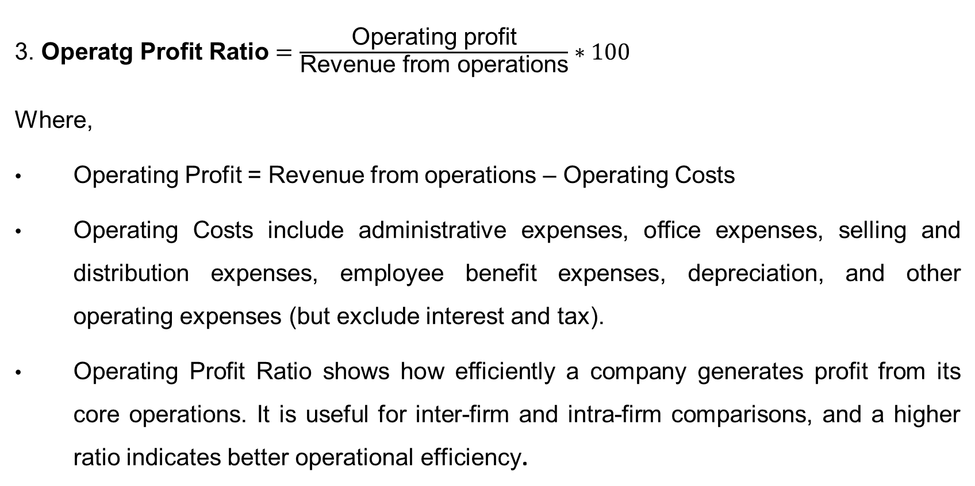
Profitability Ratios
3. $\text{O}\text{peratg} \text{Profit} \text{Ratio}=\frac{\text{Operating} \text{profit}}{\text{Revenue} \text{from} \text{operations}}∗100$
Where,
Operating Profit = Revenue from operations – Operating Costs
Operating Costs include administrative expenses, office expenses, selling and distribution expenses, employee benefit expenses, depreciation, and other operating expenses (but exclude interest and tax).
Operating Profit Ratio shows how efficiently a company generates profit from its core operations. It is useful for inter-firm and intra-firm comparisons, and a higher ratio indicates better operational efficiency.

Slide 40
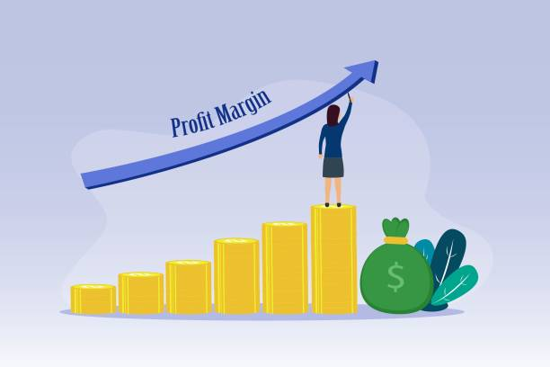
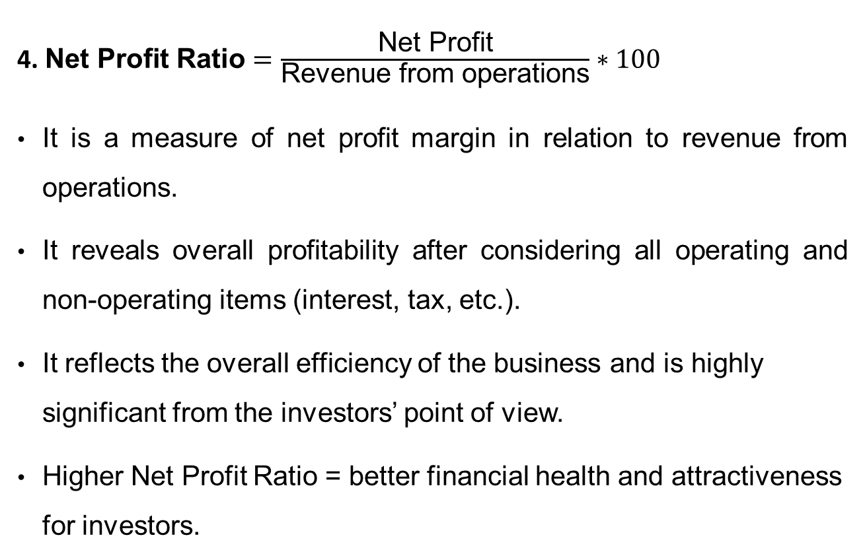
Profitability Ratios
4. $\text{N}\text{et} \text{Profit} \text{Ratio}=\frac{\text{Net} \text{Profit}}{\text{Revenue} \text{from} \text{operations}}∗100$
It is a measure of net profit margin in relation to revenue from operations.
It reveals overall profitability after considering all operating and non-operating items (interest, tax, etc.).
It reflects the overall efficiency of the business and is highly significant from the investors’ point of view.
Higher Net Profit Ratio = better financial health and attractiveness for investors.

Slide 41
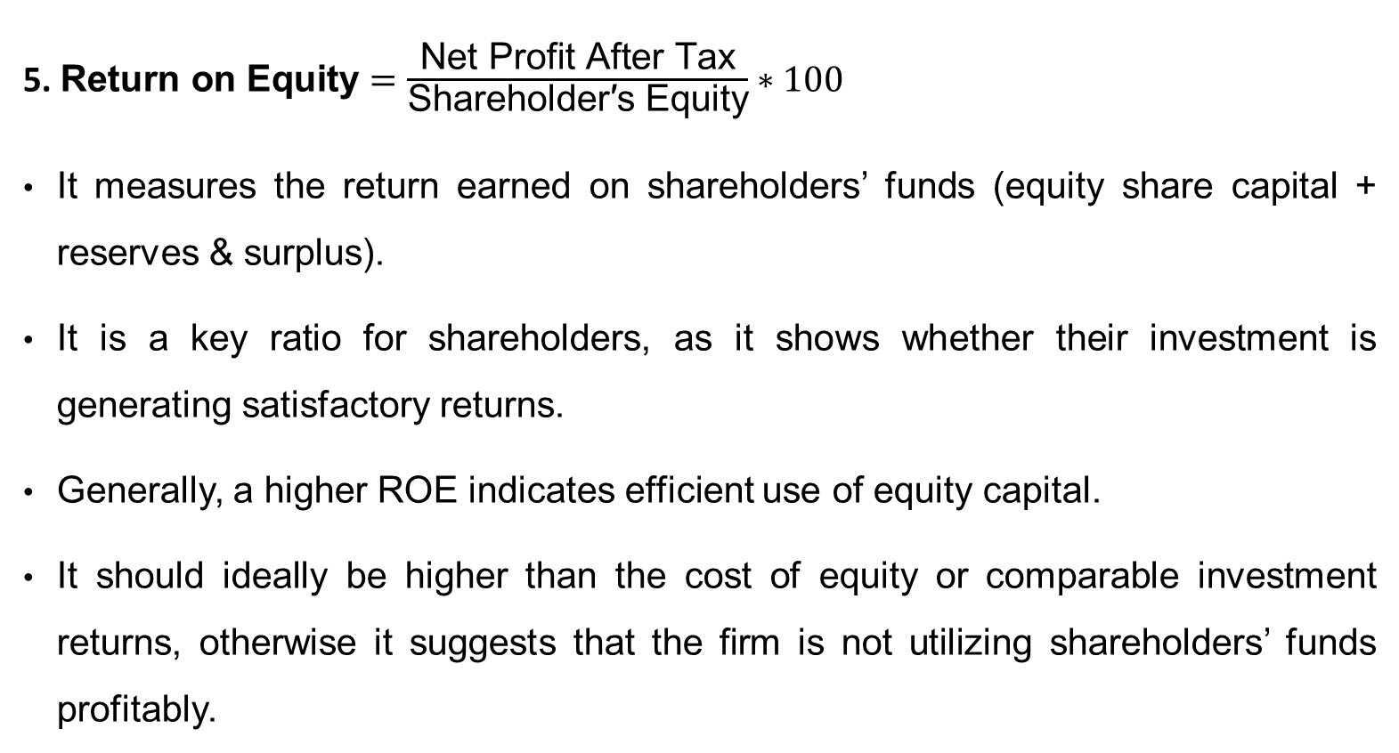
Profitability Ratios
5. $\text{R}\text{eturn} \text{on} \text{Equity}=\frac{\text{Net} \text{Profit} \text{Afte}\text{r} \text{Tax}}{\text{Shareholder}\text{′}\text{s} \text{Equity}}∗100$
It measures the return earned on shareholders’ funds (equity share capital + reserves & surplus).
It is a key ratio for shareholders, as it shows whether their investment is generating satisfactory returns.
Generally, a higher ROE indicates efficient use of equity capital.
It should ideally be higher than the cost of equity or comparable investment returns, otherwise it suggests that the firm is not utilizing shareholders’ funds profitably.

Slide 42

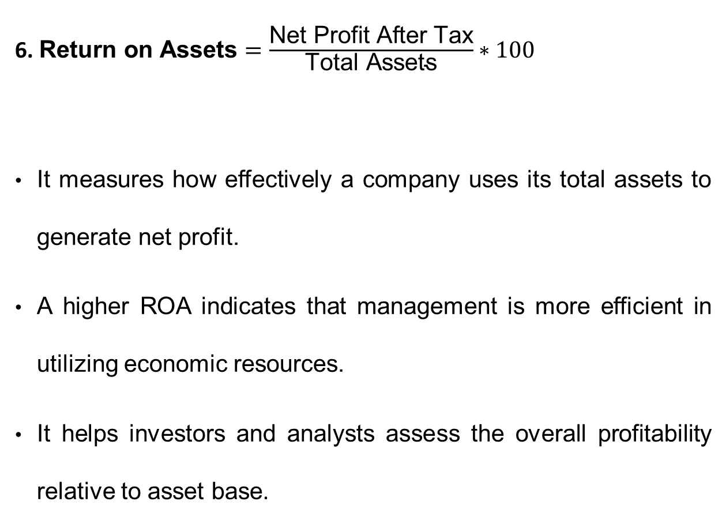
Profitability Ratios
6. $\text{R}\text{eturn} \text{on} \text{Assets}=\frac{\text{Net} \text{Profit} \text{After} \text{Tax}}{\text{Total} \text{Assets}}∗100$
It measures how effectively a company uses its total assets to generate net profit.
A higher ROA indicates that management is more efficient in utilizing economic resources.
It helps investors and analysts assess the overall profitability relative to asset base.

Slide 43
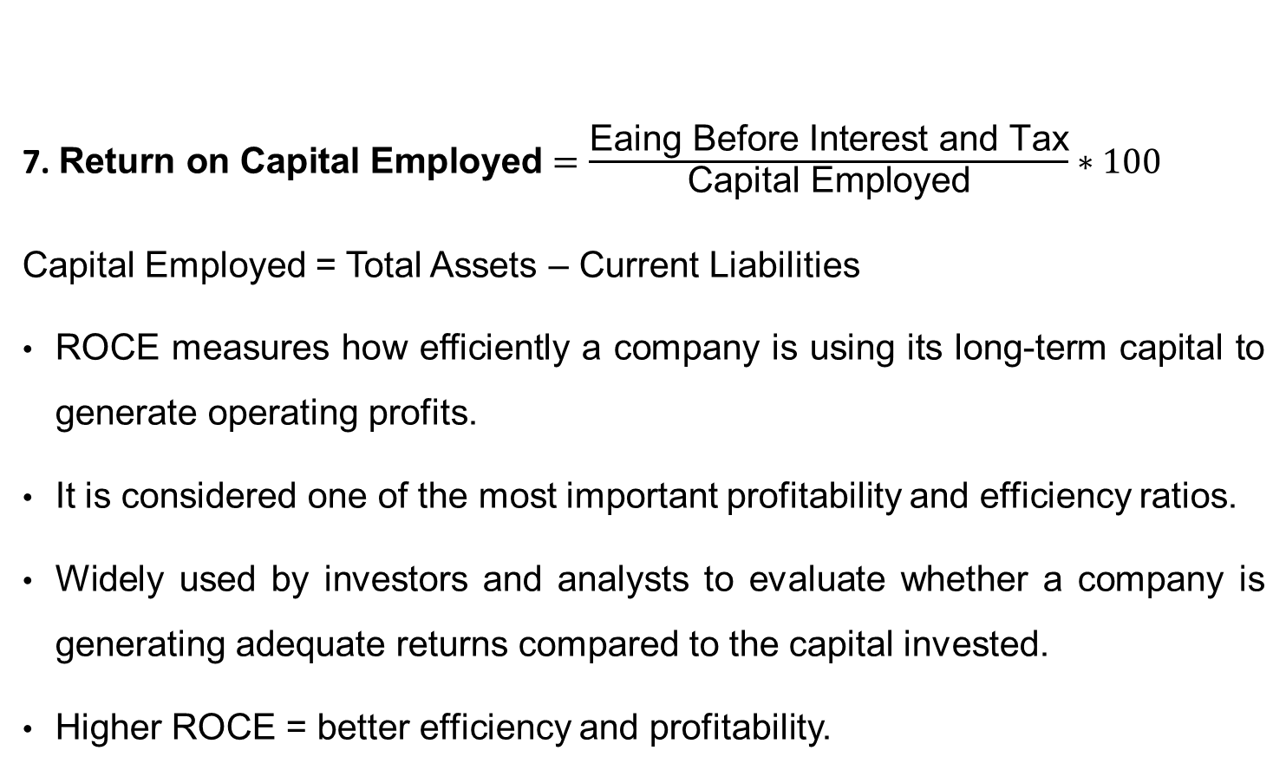
Profitability Ratios
7. $\text{R}\text{eturn} \text{on} \text{Capital} \text{Employed}=\frac{\text{Eaing} \text{Before} \text{Interest} \text{and} \text{Tax}}{\text{Capital} \text{Employed}}∗100$
Capital Employed = Total Assets – Current Liabilities
ROCE measures how efficiently a company is using its long-term capital to generate operating profits.
It is considered one of the most important profitability and efficiency ratios.
Widely used by investors and analysts to evaluate whether a company is generating adequate returns compared to the capital invested.
Higher ROCE = better efficiency and profitability.

Slide 44

Valuation Ratios
Valuation ratios link a company’s market value (share price) with its fundamentals such as earnings, book value, sales, or dividends.
They help investors judge if a stock is undervalued, fairly valued, or overvalued.
Useful for comparing companies within the same industry or across markets.
Guide buy/hold/sell decisions and reflect market expectations about future growth

Slide 45

Valuation Ratios
Valuation ratio include the fallowing:
Earning Per Share (EPS)
Dividend Per Share (DPS)
Book Value Per Share
Price-to-Book ratio
Price Earning Ratio (PE Ratio)

Slide 46
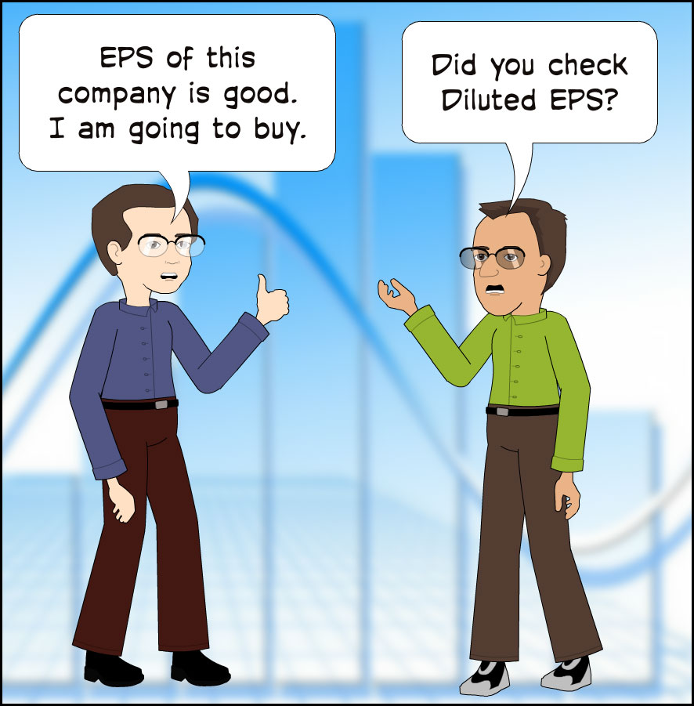
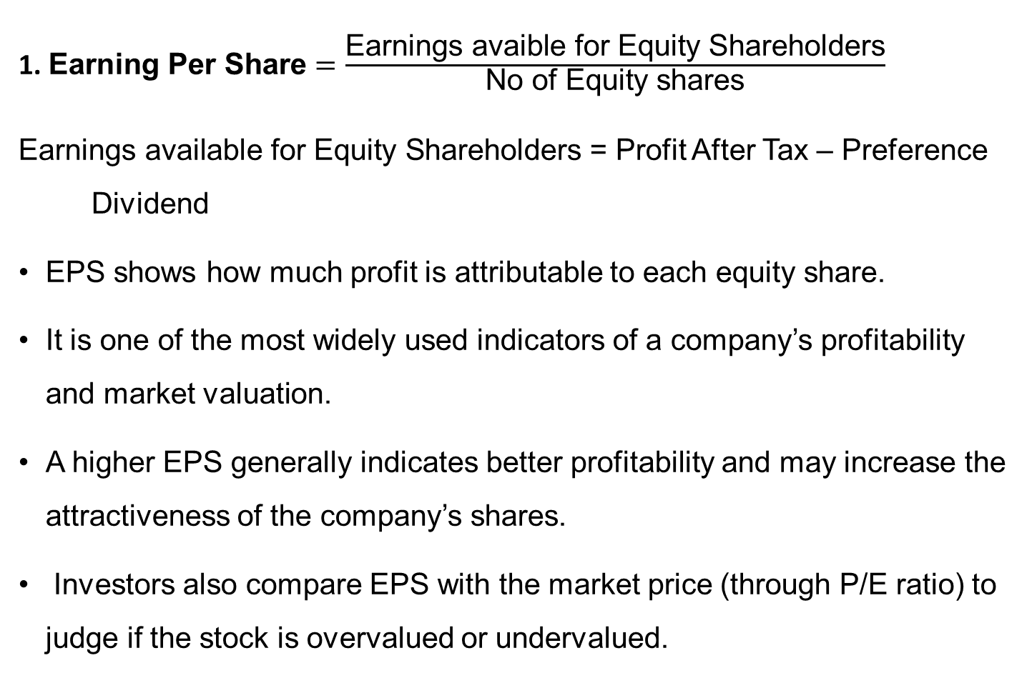
Valuation Ratios
1. $\text{E}\text{arning} \text{Per} \text{Share}=\frac{\text{Earnings} \text{avaible} \text{for} \text{Equity} \text{Shareholders}}{\text{No} \text{of} \text{Equity} \text{shares}}$
$\text{Earnings} \text{available} \text{for} \text{Equity} \text{Shareholders}$ = Profit After Tax – Preference Dividend
EPS shows how much profit is attributable to each equity share.
It is one of the most widely used indicators of a company’s profitability and market valuation.
A higher EPS generally indicates better profitability and may increase the attractiveness of the company’s shares.
Investors also compare EPS with the market price (through P/E ratio) to judge if the stock is overvalued or undervalued.

Slide 47
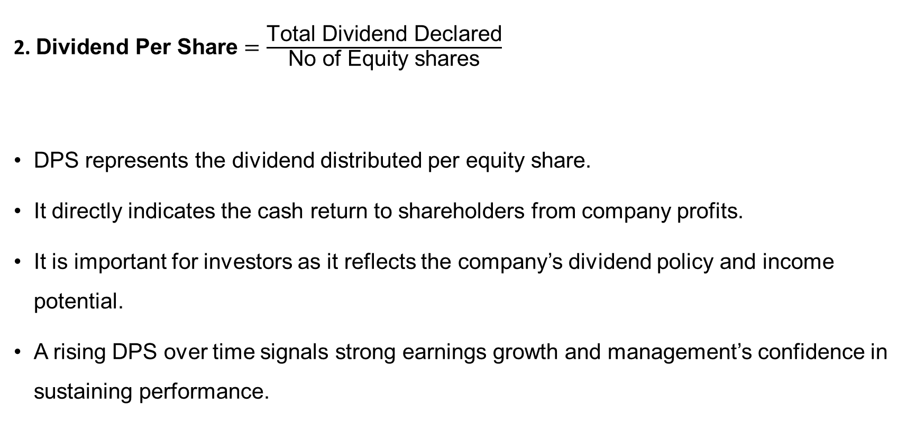
Valuation Ratios
2. $\text{D}\text{ividend} \text{Per} \text{Share}=\frac{\text{Total} \text{Dividend} \text{Declared}}{\text{No} \text{of} \text{Equity} \text{shares}}$
DPS represents the dividend distributed per equity share.
It directly indicates the cash return to shareholders from company profits.
It is important for investors as it reflects the company’s dividend policy and income potential.
A rising DPS over time signals strong earnings growth and management’s confidence in sustaining performance.

Slide 48

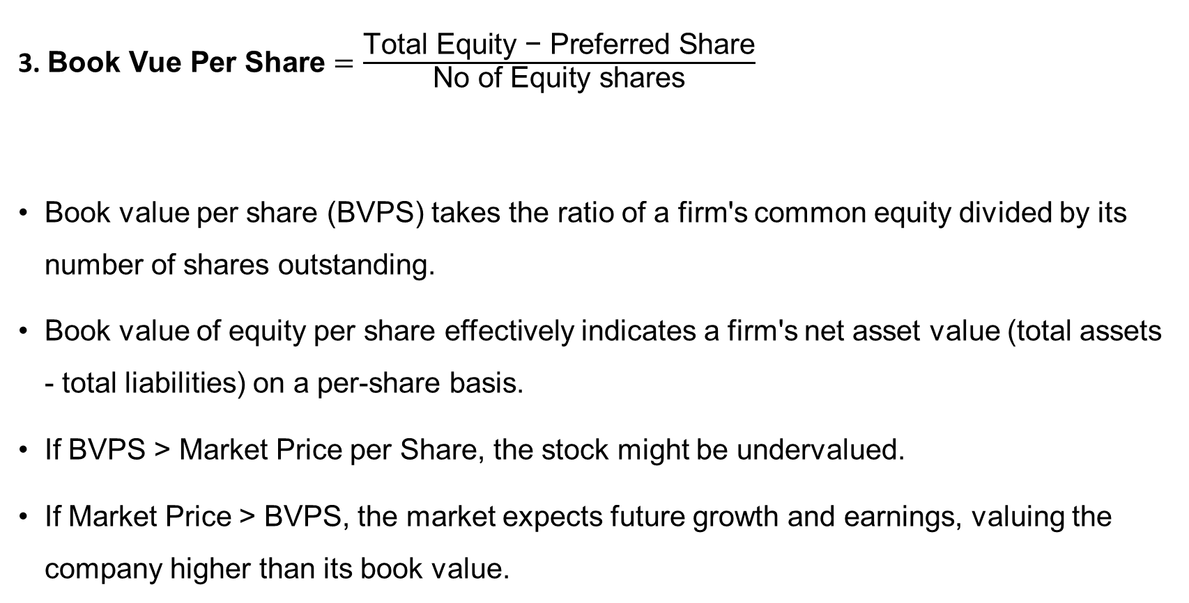
Valuation Ratios
3. $\text{B}\text{ook} \text{Vue} \text{Per} \text{Share}=\frac{\text{Total} \text{Equity}\text{ − }\text{Preferred} \text{Share}}{\text{No} \text{of} \text{Equity} \text{shares}}$
Book value per share (BVPS) takes the ratio of a firm's common equity divided by its number of shares outstanding.
Book value of equity per share effectively indicates a firm's net asset value (total assets - total liabilities) on a per-share basis.
If BVPS > Market Price per Share, the stock might be undervalued.
If Market Price > BVPS, the market expects future growth and earnings, valuing the company higher than its book value.

Slide 49

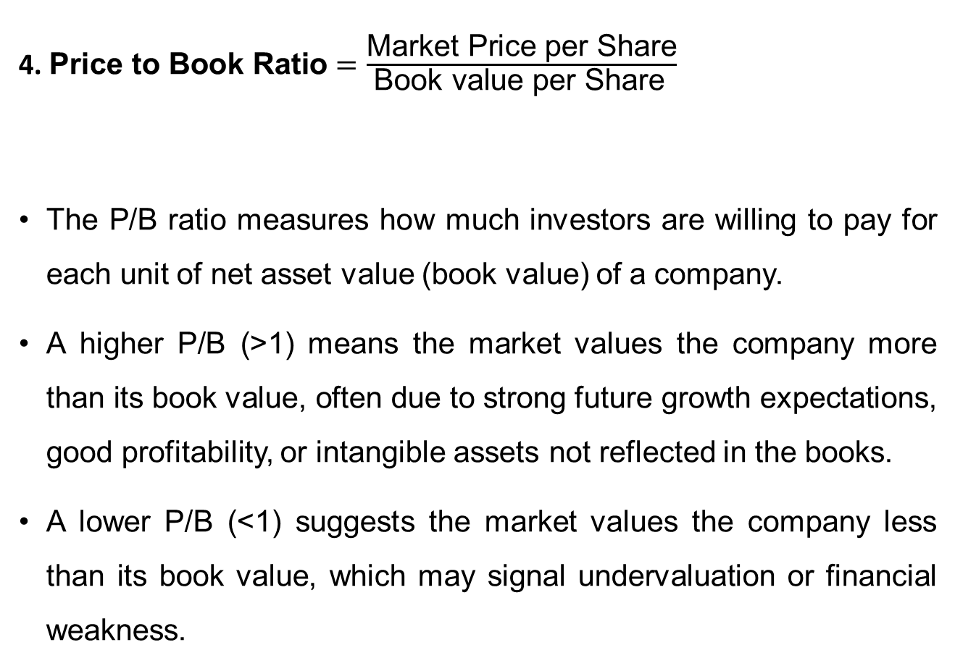
Valuation Ratios
4. $\text{P}\text{rice} \text{to} \text{Book} \text{Ratio}=\frac{\text{Market} \text{Price} \text{per} \text{Share}}{\text{Book} \text{value} \text{per} \text{Share} }$
The P/B ratio measures how much investors are willing to pay for each unit of net asset value (book value) of a company.
A higher P/B (>1) means the market values the company more than its book value, often due to strong future growth expectations, good profitability, or intangible assets not reflected in the books.
A lower P/B (<1) suggests the market values the company less than its book value, which may signal undervaluation or financial weakness.

Slide 50
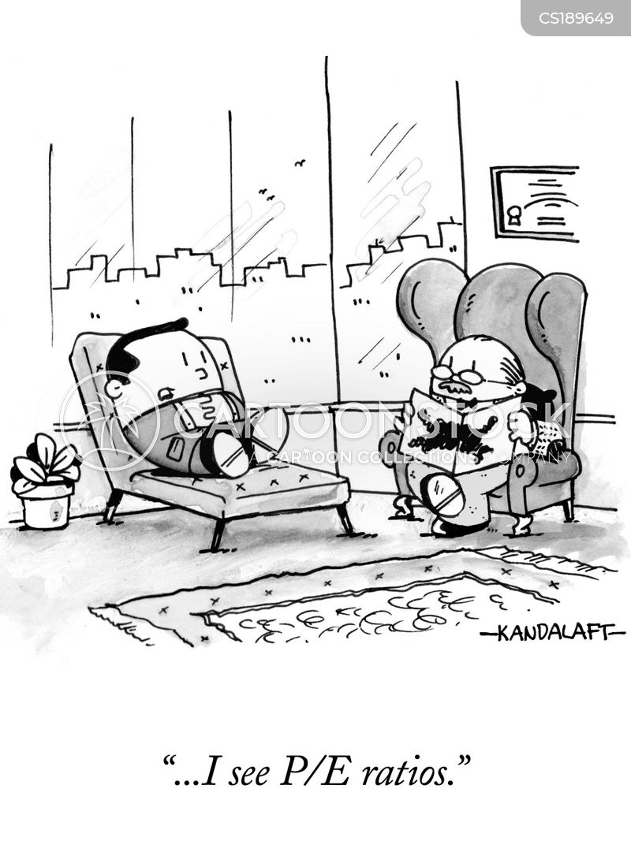
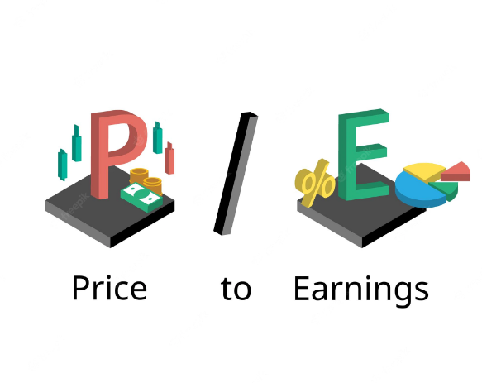
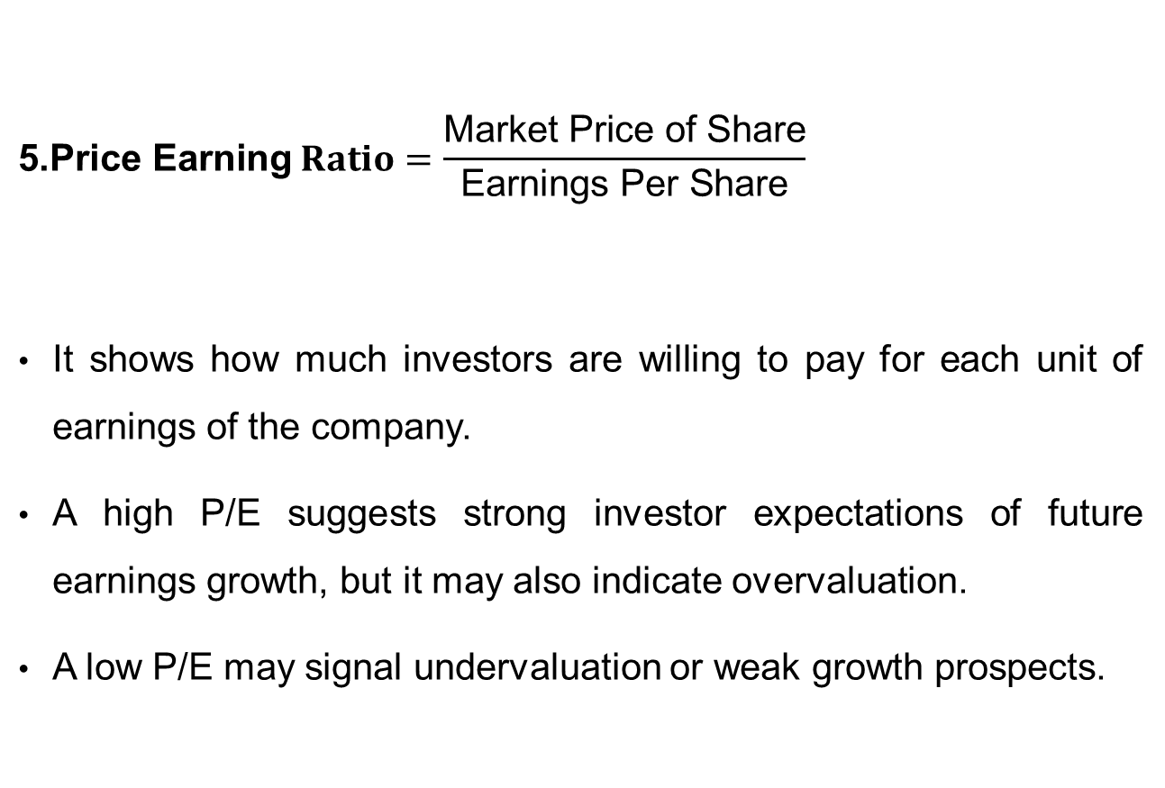
Valuation Ratios
$$\text{5.}\text{Price} \text{E}\text{arning} Ratio=\frac{\text{Market} \text{Price} \text{of} \text{Share}}{\text{Earnings} \text{Per} \text{Share}}$$
It shows how much investors are willing to pay for each unit of earnings of the company.
A high P/E suggests strong investor expectations of future earnings growth, but it may also indicate overvaluation.
A low P/E may signal undervaluation or weak growth prospects.

Slide 51
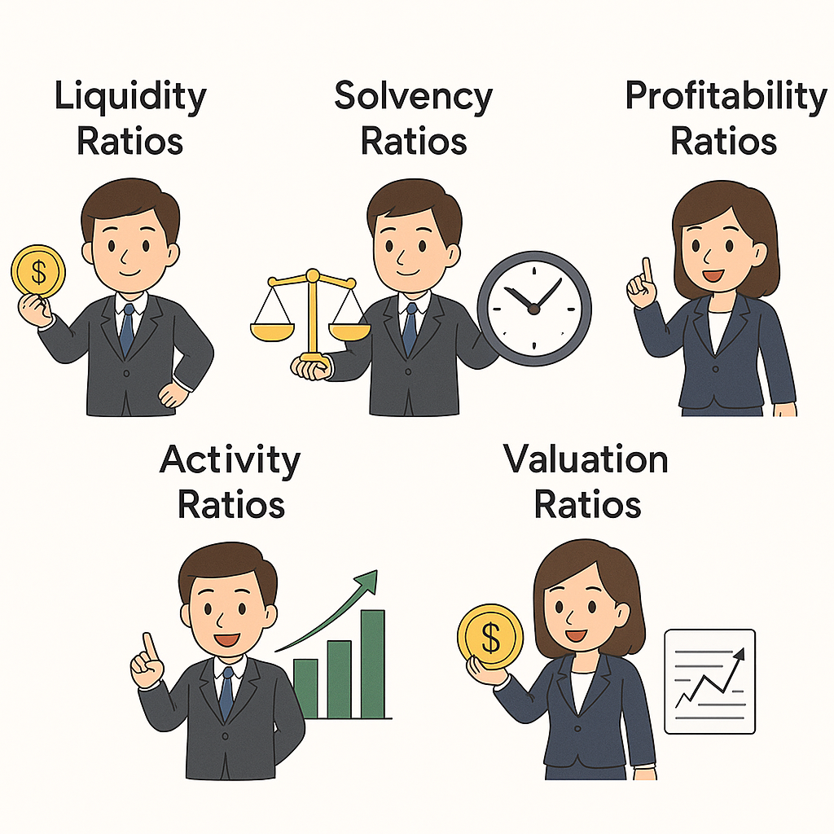
Which ratio is important for what?

Slide 52
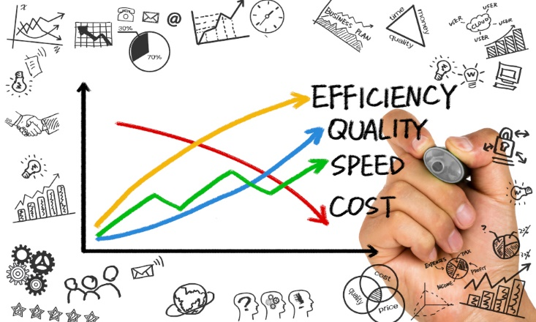
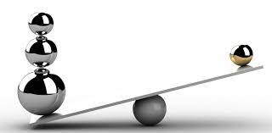
Advantages of Ratio Analysis
Provides useful insights for evaluating the effectiveness of management decisions.
Converts raw financial data into understandable ratios and establishes meaningful relationships.
Enables comparison across time periods, between companies, or against industry standards.
Highlights weak spots in performance that require management attention.
Ratios reveal changes in performance that help management assess strengths, weaknesses, opportunities, and threats.

Slide 53

Limitations of Ratio Analysis
Any weakness or manipulation in statements affects ratios
Non-financial aspects like employee skills or brand value are not considered
Ratios are only as accurate as the financial information used.
Variations in methods (depreciation, inventory) make comparisons difficult.
Price-level changes can distort ratio results.
Ratios mainly explain past performance, not future trends.
Focused on past data, may not reflect current realities

Slide 54
Exercise 1. Profit to sales is 2% and the amount of profit is said to be Rs 5 Lac. Then what is the amount of Sales?
Answer : Net Profit Ratio = (Net Profit / Sales ) x 100
2 = (5 x100) /Sales
Therefore Sales = 500/2 = Rs.250 Lac

Slide 55
Exercise 2. A Company has a Net Worth of Rs. 5 Lac, Term Liabilities of Rs. 10 Lac. Fixed Assets are worth Rs. 16 Lac, and Current Assets are Rs. 25 Lac. There are no intangible Assets or other non-current assets. Calculate its Net Working Capital.
Answer: Total Assets = FA+CA =16 + 25 = Rs. 41 Lac
Total Liabilities = NW + LTL + CL = 5 + 10+ CL = 41 Lac
Current Liabilities = TA - (NW+TL) = 41 – 15 = 26 Lac
Therefore, Net Working Capital = C. A – C.L
= 25 – 26 = (- )1 Lac

Slide 56
Exercise 3 : Current Ratio of a concern is 1 : 1 What will be the Net Working Capital ?
Answer : It suggests that the Current Assets are equal to Current Liabilities, hence the NWC would be NIL ( since NWC = C.A - C.L )
Exercise 4 : Suppose the Current Ratio is 4 : 1. I Net Working Capital is Rs 30,000/-. Find the amount of Current Assets?
Answer : Current Liabilities-Current Assets=4a - 1a = 30,000
Therefore, a = 10,000, i.e., Current Liabilities is Rs. 10,000
Hence Current Assets would be 4a = 4 x 10,000 = Rs.40,000/-

Slide 57
EXERCISE 5 . A firm sold its stocks for cash to meet its liquidity needs. Which of the following ratios would be affected?
Debt Equity Ratio
Current Ratio
Debt Service Coverage Ratio
Quick Ratio
EXERCISE 6. A company is found to be carrying a high Debt-Equity Ratio. To improve this, a bank may suggest that the company :
Raise long-term interest-free loans from friends and relatives
Raise long-term loans from Institutions
Increase the Equity by way of Bonus Issue
Issue Rights shares to existing shareholders.

Slide 58
EXERCISE 7. Which of the following is a fictional Asset?
Goodwill
Preliminary Expenses
Pre-operative expenses
Book Debts which have become doubtful of recovery
EXERCISE 8. Which of the following is not considered a Quick Asset?
Cash and Bank balances
Bank Fixed Deposits
Current Book Debts
Loans and Advances

Slide 59
EXERCISE 9. Debt Service Coverage Ratio (DSCR) shows
Excess of current assets over current liabilities
Number of times the value of fixed assets covers the amount of the loan
Number of times the company’s earnings cover the payment of interest and repayment of principal of long-term debt
Effective utilization of assets

